Slide 1
Air Bearing Auto-Balancer
Dmitriy Rivkin

Slide 2
Objective
Automated balancing of air bearing with minimal human involvement
Balancing means center of gravity is co-located with center of rotation, eliminating torque due to gravity

Slide 3
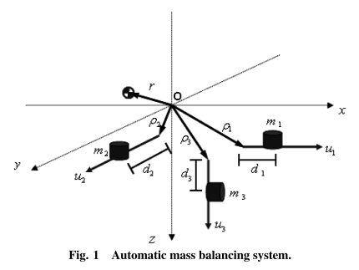
Basics
Balancing is achieved using three linearly translating motorized masses
Notes:
Kim and Agrawal

Slide 4
Basics
Balancing happens offline
Weights not being adjusted during sat testing
Coarse adjustments are manual
Allows smaller sliding weights, increased precision, relaxed requirement on actuators
Battery powered

Slide 5
Sensors
IMU
Gravity vector
Rotation rates
Inclinometers
Can give better gravity vector than IMU

Slide 6
Actuators
Desirable traits
High force
High detent force (when turned off)
Low magnetic interference
High precision
High accuracy

Slide 7
Actuators
Piezo Motors > Electromagnetic Motors
Better in all respects mentioned above
Simpler (less moving parts)
But:
Potentially more costly
Smaller displacement
Complicated to drive

Slide 8
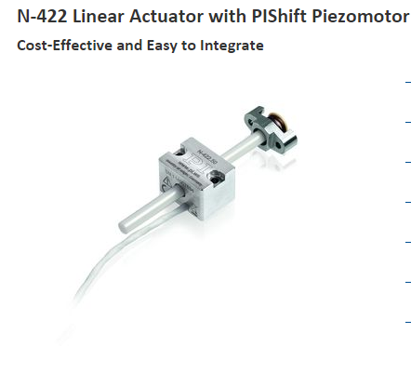
Proposed Actuator 1
PI N-422
7N push force
10N hold force
35mm travel
I think this can be increased
No encoder (add later if needed)
4 N/um stiffness

Slide 9
Proposed Actuator 1
100g, 4 channel driver available for the N-422
Cost:
$772 per actuator
$1101 for the driver
Lead time: 4 – 5 weeks

Slide 10
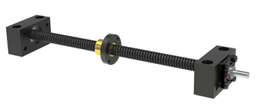
Proposed Actuator 2
A stepper motor turns a lead screw with an anti-backlash nut on it
Notes:
Photo cred: nook industries

Slide 11
Proposed Actuator 2 Hardware
Lead Screw:
Helix Linear ¼” diameter, .024” lead, Acme thread
Nut:
Helix Linear anti-backlash nuts, 1-3lb spring
Motor:
Lin Engineering 0.9°/step, hybrid, stepper motors

Slide 12
Proposed Actuator 2
Advantages:
High force
Large travel
Low cost
Short lead time
Disadvantages:
Lower resolution
Potentially lower “stiffness”
Permanent magnets in stepper motor may affect performance of magnetometers on test bed

Slide 13
Side By Side Performance Comparison of Actuators 1 and 2
Metric | Piezo | Lead Screw
Precision | 0.3 um (datasheet) | 1.5 um (computed)
Stiffness (how much will the weight move around when the bearing is tilted) | 4 N/um (about 0.5um deformation with tilt of 30 degrees) | Small but unquantified (guess a few microns, according to the company)
Open loop accuracy | Not specified in datasheet (probably very good) | 7.62 um/inch (due to accuracy of lead screw manufacture)
Max Unbalance Torque with 500g weight (assuming we were using perfect sensors for the balancing) | 1.5 uNm (about 1/1000th of reaction wheel torque) | 7.5 uNm (about 1/200th of reaction wheel torque)
Size (qualitative comparison) |  | For the same throw this would be an inch or two longer than the Piezo approach, but would not require room at the back for the shaft. Other dimensions similar
Weight (qualitative comparison) |  | Slightly heavier (10%-20%)
Maximum throw | 3.5cm | Several feet
Max mass on vertical actuator | 700g | 2.5kg
Drive electronics | Non-standard & expensive | Standard & inexpensive

Slide 14
Side By Side Cost Comparison of Actuators 1 and 2
Actuator | $772*3 = $2316 (4-5 week lead) | $64*3 = $192 (1-2 week lead)
Driver | $1101*1 = $1101 (4-5 week lead) | $30*3 = $90 (estimated, no lead)
Lead screw and nut | N/A | $63.96*3 = 191.88
Other materials | $100*1 = $100 (estimated, no lead) | $100*1 = $100 (estimated, no lead)
Total Cost of Materials | $3517 | $574
Machining time | 14hr*84 $/hr = $1176 | 16hr*84$/hr = $1344
Total cost | $4693 | $1918

Slide 15
The Question of Machining
This project will likely require some precise machining
Professional machining costs are significant
Non-professional machining can be done at no cost
Precision may be inferior

Slide 16
Balancing Approaches
Most rely on spinning the test-bed and measuring rotational rates
Can be grouped into batch estimation type solutions and feedback solutions

Slide 17
Balancing Approaches
Batch estimation (Li and Gao, Chesi and Gong)
Develop equations of motion
Actuate system (with reaction wheels)
Use some (least squares) approach to find best estimate of CoG
Once CoG is known, move masses to compensate
Sensitive to knowledge of actuator parameters
Need to know MOI (or estimate it at the same time)
Multiple iterations needed
Requires actuation

Slide 18
Balancing Approaches
Alternative Approach to Batch Estimation
Move masses
Measure change of equilibrium position
Compute center of mass
Move masses to compensate

Slide 19
Balancing Approaches
Feedback approach (Kim and Agrawal, Chesi and Gong)
Actuate system
While system is spinning, apply feedback control law to drive external torque to zero
Requires knowledge of initial MOI
Requires IMU
Requires actuation

Slide 20
My Proposed Approach
Step 1: Move CoG to Z axis using gravity vector feedback
Move around the weights until the bearing sits flat, but is still bottom heavy

Slide 21
My Proposed Approach
Step 2: Tilt the air bearing and rest it on a force guage. Slide up z axis mass until force guage reads zero.
Force on the guage is proportional to the torque being applied by gravity
Z axis actuator must be directly below CoR

Slide 22
Benefits of My Approach
No need to know MOI
Important since we plan on switching test-beds a lot
No need for accurate knowledge of actuator position
Not sensitive to x and y axis actuator alignment
Computationally non-intensive

Slide 23
Plan
Hardware is pretty much the same for all of the possible approaches
Step 1: Build the rig well
My method shouldn’t be very sensitive to the precision of the build, but others may be
Step 2: Implement my method using IMU for gravity vector
Step 3: If it doesn’t work, we try something that’s been published (hardware is already set up)

Slide 24
Build Plan
See SolidWorks mock up

Slide 25
Keep in Mind
No mass motions
Rigid platform
All components well secured
Wires
Precise placement of actuators (especially z axis) and sensors is highly desirable
Use quality machining

Slide 26
Some References
Chesi et al. “Automatic Mass Balancing of a Spacecraft Three-Axis Simulator: Analysis and Experimentation.” 2014
Kim, J.J. and Agrawal, B.N. “Automatic Mass Balancing of Air-Bearing-Based Three-Axis Rotational Spacecraft Simulator.” 2009.
Meissner, D.M. Thesis. 2009. Naval Postgraduate School.
Li, Y. and Gao,Y. “Equations of Motion for the Automatic Balancing System of 3-DOF Spacecraft Attitude Control Simulator”.
Smith, G.A. “Dynamic Simulators for Test of Space Vehicle Attitude Control Systems.”1964.

